Slide 1


Technical Presentation
Content Delivery Networks (CDNs) and Their Role in Cloud Services
Presented By G.Kavinashree 192511391

Slide 2

Objective:
Page 02
The objective of this presentation is to understand the concept of Content Delivery Networks (CDNs) and their importance in modern cloud computing. It explains how CDN architecture works, why organizations use it to improve performance, and how it enhances the speed, reliability, and security of web applications through a real-world example.

Slide 3

Definition & Core Technical Explanation:
Page 03
What is a Content Delivery Network (CDN)?
A Content Delivery Network (CDN) is a geographically distributed network of servers that stores cached copies of web content and delivers them from the server closest to the user. This minimizes the distance data travels, resulting in faster page loading, lower latency, and a smoother user experience.
Core Functions
Stores frequently accessed content closer to users. Delivers content through the nearest edge server.
Reduces the workload on the origin server. Improves website speed and reliability.
Balances network traffic efficiently.
Enhances availability during periods of high demand.

Slide 4

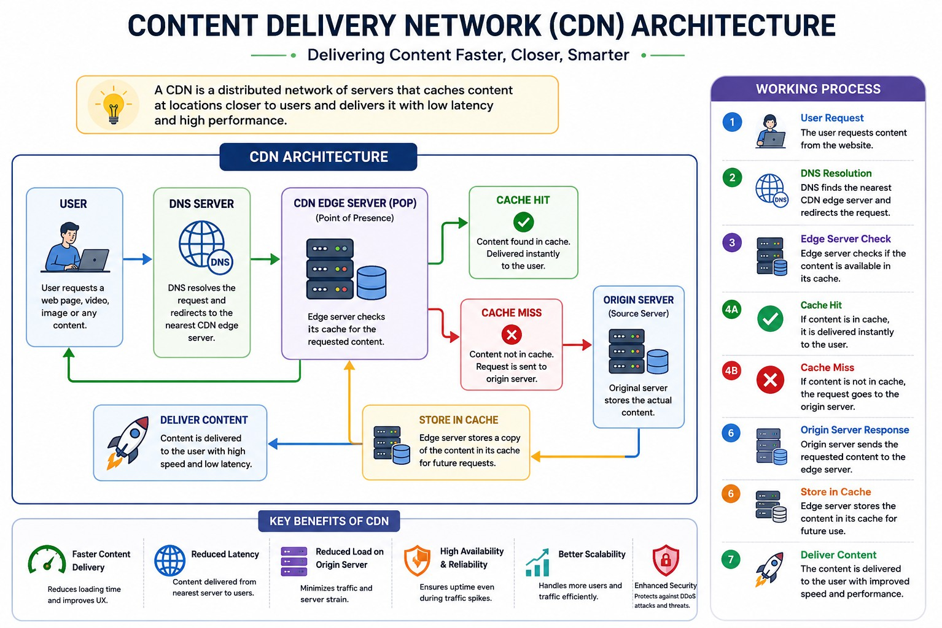

Slide 5

Industry Relevance:
Page 04
Why are CDNs Important?
As websites and cloud applications serve users across different regions, fast and reliable content delivery becomes essential. CDNs improve performance by delivering content from the nearest edge server instead of the central server.
Benefits for Organizations
Faster website loading. Reduced network latency. Lower bandwidth costs.
Better scalability during high traffic. Improved user satisfaction.
Protection against DDoS attacks. Higher availability and reliability.
Examples:
Netflix,YouTube,Amazon, Facebook,Microsoft,Spotify

Slide 6


Practical Example:
Page 06
Real-World Example: Netflix
Netflix delivers movies and TV shows to millions of users worldwide. To provide uninterrupted streaming, it uses a CDN to store popular content on edge servers located in different regions.
Without a CDN
Requests travel to a distant central server. Longer response time.
Increased buffering. Higher server workload.
With a CDN
Requests are redirected to the nearest edge server. Videos load much faster.
Reduced buffering.
Better viewing experience. Lower traffic on the origin server.

Slide 7

Advantages and Challenges:
Page 07
Advantages
Faster content delivery. Reduced latency.
Improved website performance. Lower bandwidth consumption. Better scalability for growing traffic. High availability and reliability.
Enhanced security through traffic distribution.
Challenges
Initial deployment and maintenance costs. Cache synchronization issues.
Dynamic content is more difficult to cache. Managing a global network requires expertise.

Slide 8

Conclusion:
Page 08
Content Delivery Networks have become a fundamental component of cloud computing by enabling faster, more secure, and reliable delivery of digital content. By distributing cached content across multiple edge servers, CDNs reduce latency, improve application performance, and ensure users receive content quickly regardless of their location.

Slide 9
Thank You

